Slide 1
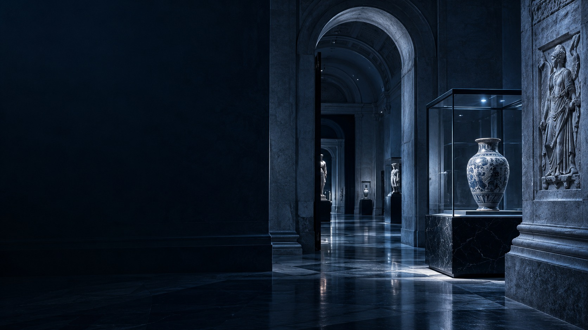
A MUSEUM EVENING, IN A DIFFERENT LIGHT
After
Closing.
Look closer. Listen differently.
Flashlight observation · A conservator’s talk
A sound walk
SATURDAY / 18:00–21:00 / UP TO 40 ADULTS
AFTER CLOSING / FICTIONAL CULTURAL EVENT
01 / 08

Slide 2
01 / THE AUDIENCE
Curiosity after dark.
For adults who want
a different Saturday.
First-time museum visitors, friends and solo guests.
No specialist knowledge needed.
40 adults. One shared evening.
AFTER CLOSING / FICTIONAL CULTURAL EVENT
02 / 08

Slide 3
02 / THE PROGRAMME
Look. Ask. Listen.
01
02
03
Flashlight
observation
Conservator’s
talk
Sound
walk
Discover texture and hidden detail on approved replicas, guided by a narrow beam.
Hear how objects are cared for, see a sample demonstration, and ask questions.
Listen to footsteps, echoes and short sound cues along a guided corridor route.
18:20
19:10
20:00
AFTER CLOSING / FICTIONAL CULTURAL EVENT
03 / 08

Slide 4
03 / THE ATMOSPHERE
Silver light.
Ink-blue night.
A quiet, cinematic setting.
Orange marks the route;
the collection takes the spotlight.
Clear paths · Seats · Step-free route
Staff-issued flashlights on approved replicas.
Original works retain approved lighting.
AFTER CLOSING / FICTIONAL CULTURAL EVENT
04 / 08

Slide 5
04 / SCHEDULE & ROUTE
One evening. A clear path.
18:00
18:20
19:10
20:00
21:00
Entry
Flashlight
observation
Conservator’s
talk
Sound walk
Finish
01
02
03
04
Entrance
→
Exhibition hall
→
Talk area
→
Exit
Check-in & briefing
Flashlight observation
Talk & questions
Return flashlights
20:00 SOUND WALK
Talk area → approved corridor → exit. Finish by 21:00.
AFTER CLOSING / FICTIONAL CULTURAL EVENT
05 / 08

Slide 6
05 / THE TEAM
Three roles. One welcome.
01
02
03
Event host
Conservator
Sound-walk guide
Welcome guests; check access needs.
Guide transfers and keep time.
Count visitors; finish by 21:00.
Lead observation at 18:20.
Give the 19:10 talk and demo.
Answer questions on object care.
Check the route and sound cues.
Guide the 20:00 sound walk.
Collect flashlights at the exit.
Venue to confirm security, emergency provision and route access.
AFTER CLOSING / FICTIONAL CULTURAL EVENT
06 / 08

Slide 7
06 / THE INVITATION
Make it a night.
40
Invite with intrigue.
A silver-lit detail. A conservator’s story.
A sound-walk teaser. Share through museum
email and local cultural channels.
ADULTS MAXIMUM
Saturday
18:00–21:00
Make the details clear.
Adults only; 40-person limit. Publish the schedule,
access information and confirmed ticket price.
AFTER CLOSING / FICTIONAL CULTURAL EVENT
07 / 08

Slide 8
07 / THE NEXT STEP
Stay curious.
After Closing.
A fictional museum evening for up to 40 adults.
Saturday · 18:00–21:00
Confirm spaces and access.
Assign the three staff roles.
Rehearse the route, then invite.
AFTER CLOSING / FICTIONAL CULTURAL EVENT
08 / 08

